Slide 1

SAP Build Training for Corporate Professionals
DAY-3
www.anubhavtrainings.com

Slide 2


DISCLAIMER
The training content and delivery of this presentation is confidential, and cannot be recorded, or copied and distributed to any third party, without the written consent of Anubhav Trainings

Slide 3
Agenda
BPMS
Introduction to Business process and Management system
BPM Approach
Approaches used to manage BPM
SAP BPA
SAP Build Process Automation Capability and Subscription
Dev Experience
Understanding core Components of Build BPA and Create simple process

Slide 4

Hands on : Access SAP Build Work zone for End user

Slide 5










IAS

Slide 6
What is Business process?
In big organizations the large number of employees can only be managed when we have pre-defined, standardized processes. Processes in each area like leave request/approval, SRM purchasing, Order-to-cash, order approval, maintenance contract preparation, procure-to-pay, hiring.
It is in the best benefit of a company to comply to business process is to automate the same.
Classical SAP world (On-premised) we have SAP Workflow to automate a business process.
To create a workflow we use tcode as SWDD.
In the modern world the business process is not just about writing some sequence of steps but also require high amount of automation to bring down manual efforts like checking invoice amount from a pdf document and matching with invoice value in SAP S/4HANA database table.

Slide 7
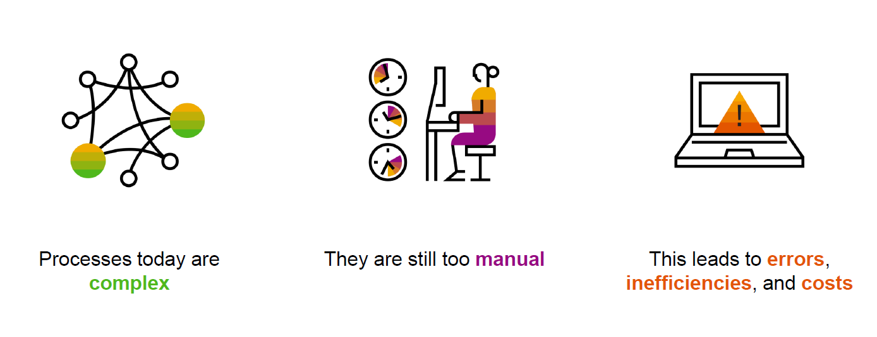
What is Business Process Management?
Business process is the heart of an ERP system and a software which manages such business processes is called BPM.
In a company running thousands of processes, it can be challenging for management to see where things are going wrong. In the end, it all comes down to how well business processes can be defined and executed.
Business Process Management Software helps you to bring structure into the large amount of your company’s business processes. It helps to prevent potential chaos and to clearly define and manage the processes.

Slide 8

Good v/s Bad Business process
Well-run processes improve communication between people and departments. Accuracy, speed, and efficiency are big advantages. This can eliminate daily confusion or frustration and increase accountability within a team. Rather than blaming a process for delays or failures, team members can take on more responsibility and focus on their goals.
However, not all processes are good. Even if they’re not engineered well, bad processes can still be running in your organization. While these might still get the job done somehow, it is those processes that can cause the biggest issues – for you personally and overall.

Slide 9
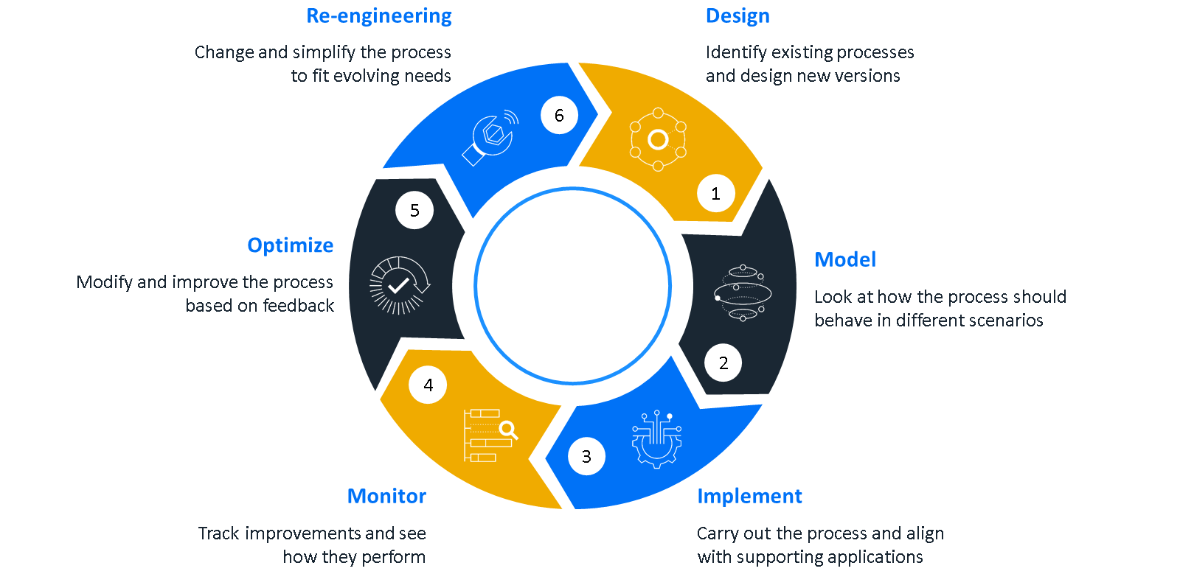
The BPM Approach
Business Process Management (BPM) is an approach used to identify, analyze, measure, and improve an organization’s processes. BPM is not to be seen as just another software in your company, but rather as a strive for operational excellence. It helps a company run faster, better, and at a lower expense, too.
This is achieved via the BPM lifecycle which consists of six stages that a company should undertake to strive for operational excellence.

Slide 10
Key roles involved in the Business Process
The key roles involved in a business process can be categorized into three different groups: Primary Participants, Secondary Participants, and Stakeholders. The following example - Roles involved in a Laptop Ordering Process - provides a simple overview.
Process Owner
Is overall, responsible for a process from the business perspective. Needs to trigger process adjustments when something does not run smoothly. E.g. the HR needs to define a smooth on-boarding of employee.
Process Initiator
Starts the process by performing an action. This can happen knowingly or unknowingly. E.g. employee who request for new laptop when he/she joins the company.
Decision Maker
Is responsible for taking decisions that influence the direction of the process. Approvals or rejections naturally lead to different process outcomes. E.g. manager who approve the new laptop request
Process Participants
Need to perform certain tasks within the process. These can be physical tasks or tasks performed within software systems. E.g. a IT executive who release the device to employee once request approved.
Process Instance Reviewer and Process Metrics Reviewer
Has a particular interest in certain process runs or the overall process metrics due to their job description.

Slide 11
SAP BTP Build Process Automation
SAP Build Process Automation is a citizen developer solution to adapt, improve, and innovate business processes with no-code workflow management and robotic process automation capabilities.
SAP Build Process Automation enables business users and technologists to become citizen developers. With powerful yet intuitive low-code and no-code capabilities, the solution supports you in driving automation by tapping into the expertise of citizen developers.
Features
Build or adapt processes with an intuitive graphical interface.
Create forms-based workflows using drag-and-drop functionality.
Develop and manage decision logic in tabular, spreadsheet-like decision tables.
Automate repetitive tasks within existing process flows using robotic process automation.
Create intelligent actions and recommendations using machine learning capabilities.
Work efficiently from a unified launchpad and task center.
Hand over projects to professional developers, who can embed actions and advanced workflows into projects initiated by citizen developers.
Support real-time, event-driven transparency into comprehensive processes and process instances with process visibility dashboards.
In addition, SAP Build Process Automation offers prebuilt content and features – such as bots, process steps, business rules, and workflow components.

Slide 12
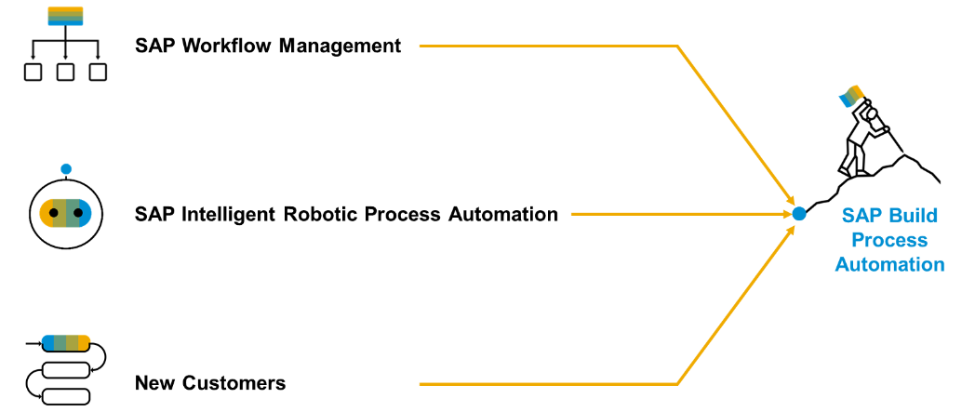
Product Overview
SAP Build Process Automation is a solution that evolved out of the former stand-alone SAP products - SAP Workflow Management and SAP Intelligent Robotic Process Automation. It provides a new citizen developer experience that didn't exist in either of the two former products.
As you or your company might have used SAP Workflow Management or SAP Intelligent Robotic Process Automation in the past, you are looking for a path into the joined solution. Fortunately, SAP Build Process Automation is fully compatible with all workflow and automation artifacts that you have created.

Slide 13

Hands-on Setup and overview of BPA

Slide 14
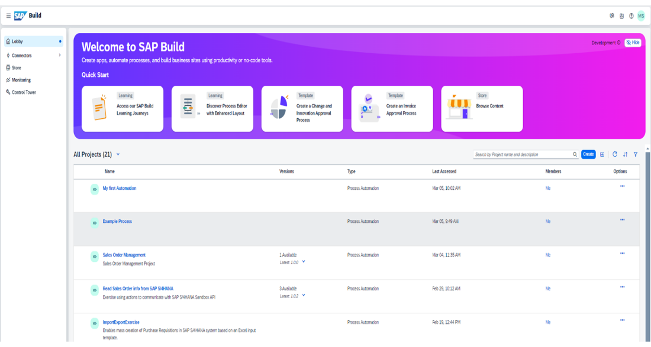
Core Components
Lobby – Centrally view and manage all build apps and business processes.
Process Builder- a LCNC design studio to design the business process and add multiple tasks
Connectors – configure connections with the systems
Store – Explore and import pre-built SAP standard process content
Monitoring – Analyze and monitor the on-going processes
Control Tower – Discover the implementation guide and configure IRPA desktop agents

Slide 15
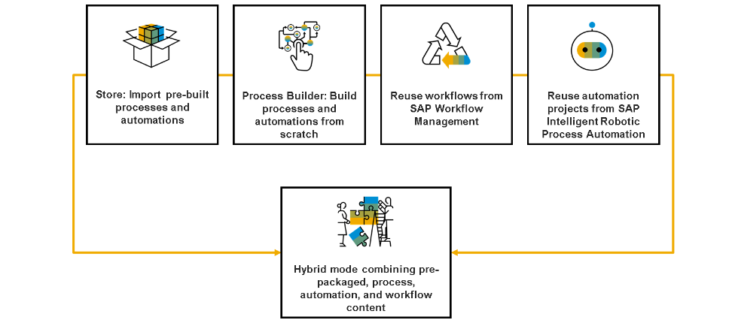
Different working models
As a person that wants to create process in SAP Build Process Automation, you can choose from a set of different working modes:
Import prebuilt processes and automations from the built-in Store.
Build custom processes and automations from scratch using the Process Builder tool.
Reuse workflows from SAP Workflow Management – either as a migration effort or when SAP Build Process Automation capabilities don't fulfill all your needs.
Reuse automation projects from SAP Intelligent Robotic Process Automation – existing SAP Intelligent Robotic Process Automation Cloud Studio projects are fully compatible with SAP Build Process Automation.
"Hybrid" mode combining pre-packaged process and workflow content.

Slide 16







Slide 17

What We Did
Let’s Summarize
www.anubhavtrainings.com

Slide 18
www.anubhavtrainings.com
Thank You
End of Day 3
www.anubhavtrainings.com

Slide 19



We’re committed to empower you to be
#FutureReady
through powerful training solutions.
We build the workforce of the future.
250+
Corporate Clients
30,000+
Learners Trained
25000+
Learners Placed
FREE WEBINARS
Sign up for free webinars with industry experts every fortnight!
Enroll Now!
Contact us today!
https://anubhavtrainings.com

